Slide 1
Organic Shale Refrac Optimization using the Extreme Limited Entry Process and Expandable Liners
October 4, 2019
Robert Barba
Integrated Energy Services Inc
Mark Villareal
Enventure Global Technology Inc

Slide 2
Executive Summary
Extreme limited entry (XLE) provides a mechanism to stimulate short spaced clusters (13.3 ft spacing proposed) with high cluster efficiency (85%)
Higher SRV=higher EURs 100% of the time
If the number of perfs per cluster are limited (one is proposed) and the hole size is uniform stage lengths can be increased without decreasing the overall SRV with a 1500 psi pressure drop across perfs post erosion
85 BPM with an expandable liner can frac a 7500 ft lateral with 38 stages vs 47 stages required if the max rate is 65 BPM with a 3.5 in cemented liner
While the expandable option up front AFE is higher than a cemented liner the elimination of 8 frac stages results in 2 fewer pumping days and a return on the incremental investment in the expandable of 6.5 to 1

Slide 3
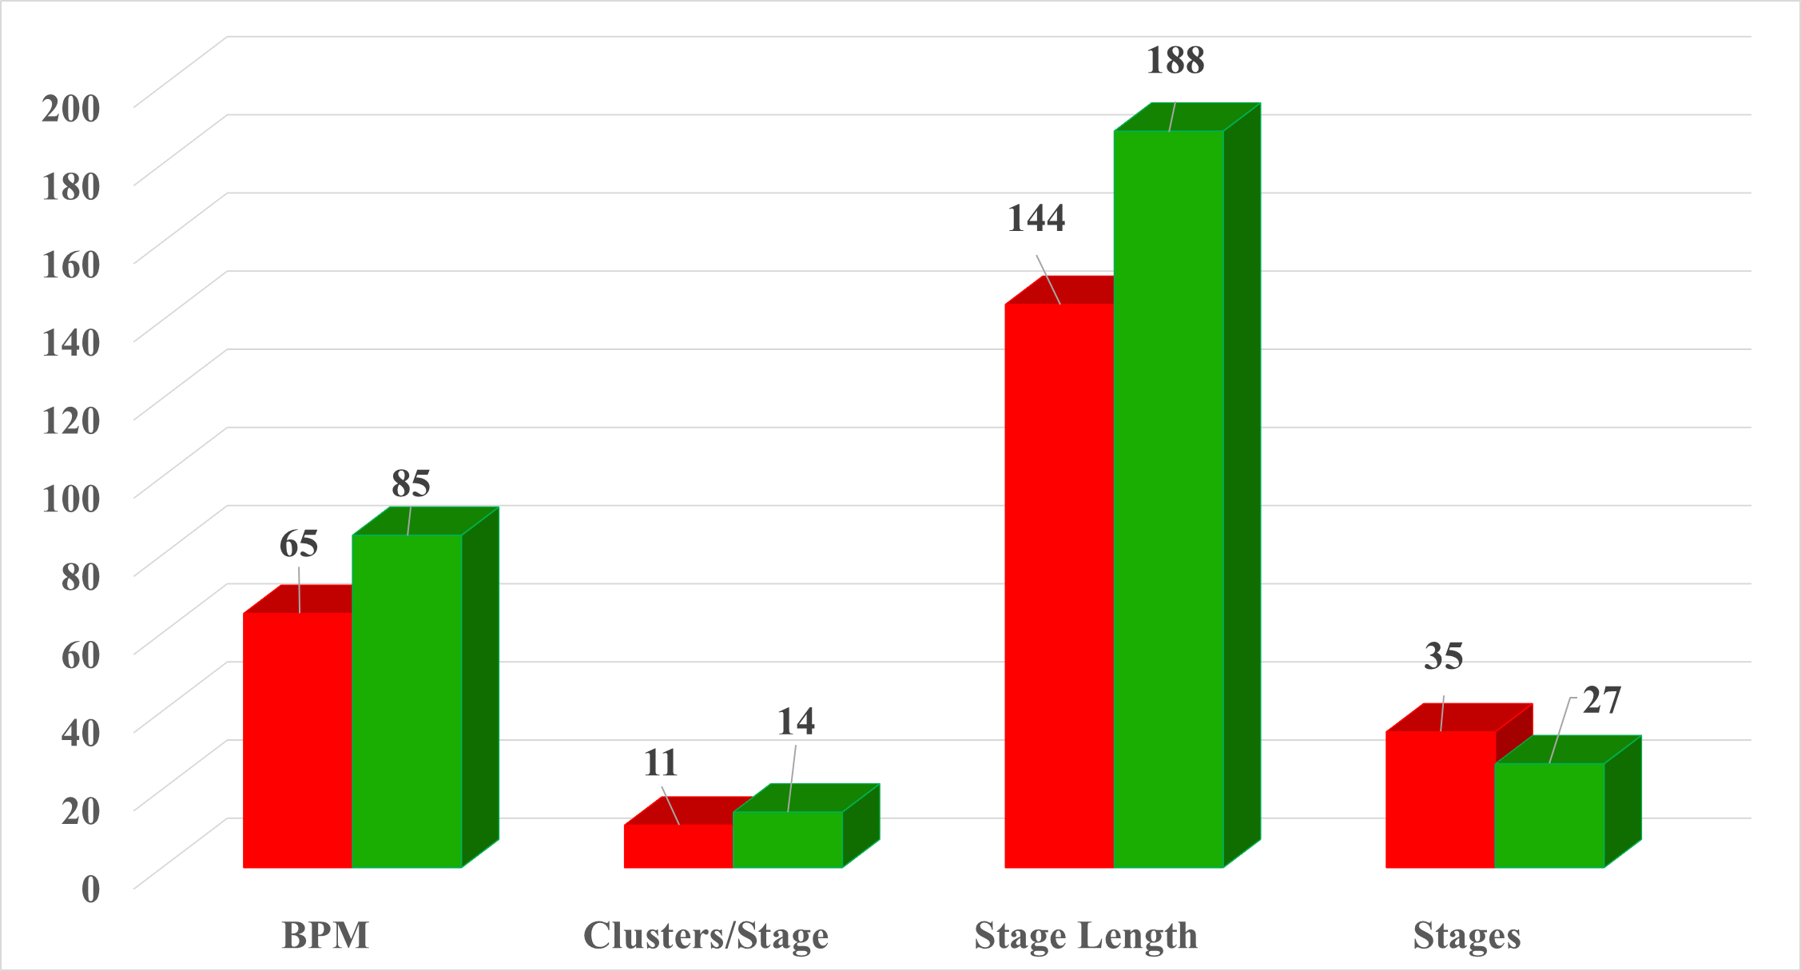
Expandable vs Cemented Liner Comparison
5000 ft lateral
3.5 in OD Cemented
4.1 in ID Expandable

Slide 4
Detailed Economic Summary

Slide 5
Refrac Main Value Drivers:
Enhance and protect production of primary wells while avoiding up to 40% losses in infill well EURS ($6.8 MM PV10 loss for a 600 MBO Permian well)
$2.6 MM Refrac vs $1.0 MM water preload with water: $4.2 MM PV10 economic advantage for refrac (avg Permian shale refrac PV $5.7 MM*)
Access and contact significant volumes of unstimulated rock
Increase production at the minimum possible cost
Implement new completion learnings
Primary Execution Challenges
Control fracture entry points to stimulate as close to 100% of the new rock and recharge 100% of the existing depleted intervals
Execute a premium optimized frac at the lowest cost per barrel possible
* Barba and Leshchyshyn, “Evaluating Refrac Potential in the Permian Wolfcamp Formation,” SPE/ICOTA Refrac Workshop April 2017

Slide 6
Eagle Ford Pressure Monitor Well Data
Cluster
Producing Well Gen I Frac 50 ft Cluster Spacing
Pressure Monitor Well 70 ft Away Drilled +/- 4 yrs later (based on frac gen)
7.5 ft of lateral drainage (SRV width) observed in monitor well
85% of rock not producing with 50 ft cluster spacing
= drained area in offset pressure monitoring well (SRV)

Slide 7
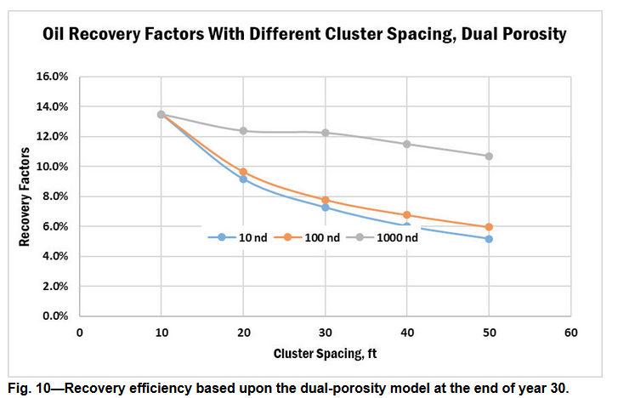
Midland Basin Wolfcamp Recovery Factor vs Cluster Spacing
Xiong , 25 May 2017 SPE “The Way Ahead”

Slide 8
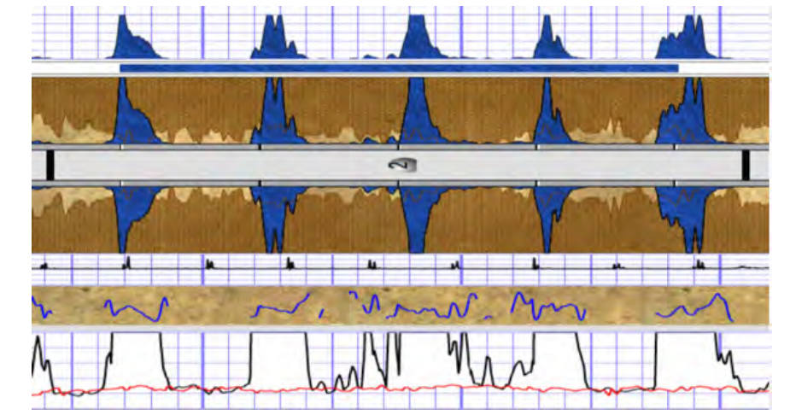
Midland Basin Wolfcamp RA Tracer Width at Wellbore
Green =
Stranded
Hydrocarbons
+/- 20 ft
+/- 22 ft
+/- 19 ft
+/- 15 ft
+/- 20 ft
URTEC paper 2902960

Slide 9
2011 US Organic Shale Stage & Cluster Spacing
Early completions large unstimulated reservoir volume
Significant stranded hydrocarbons
Significant refrac potential
SPE 144326 (2011)

Slide 10
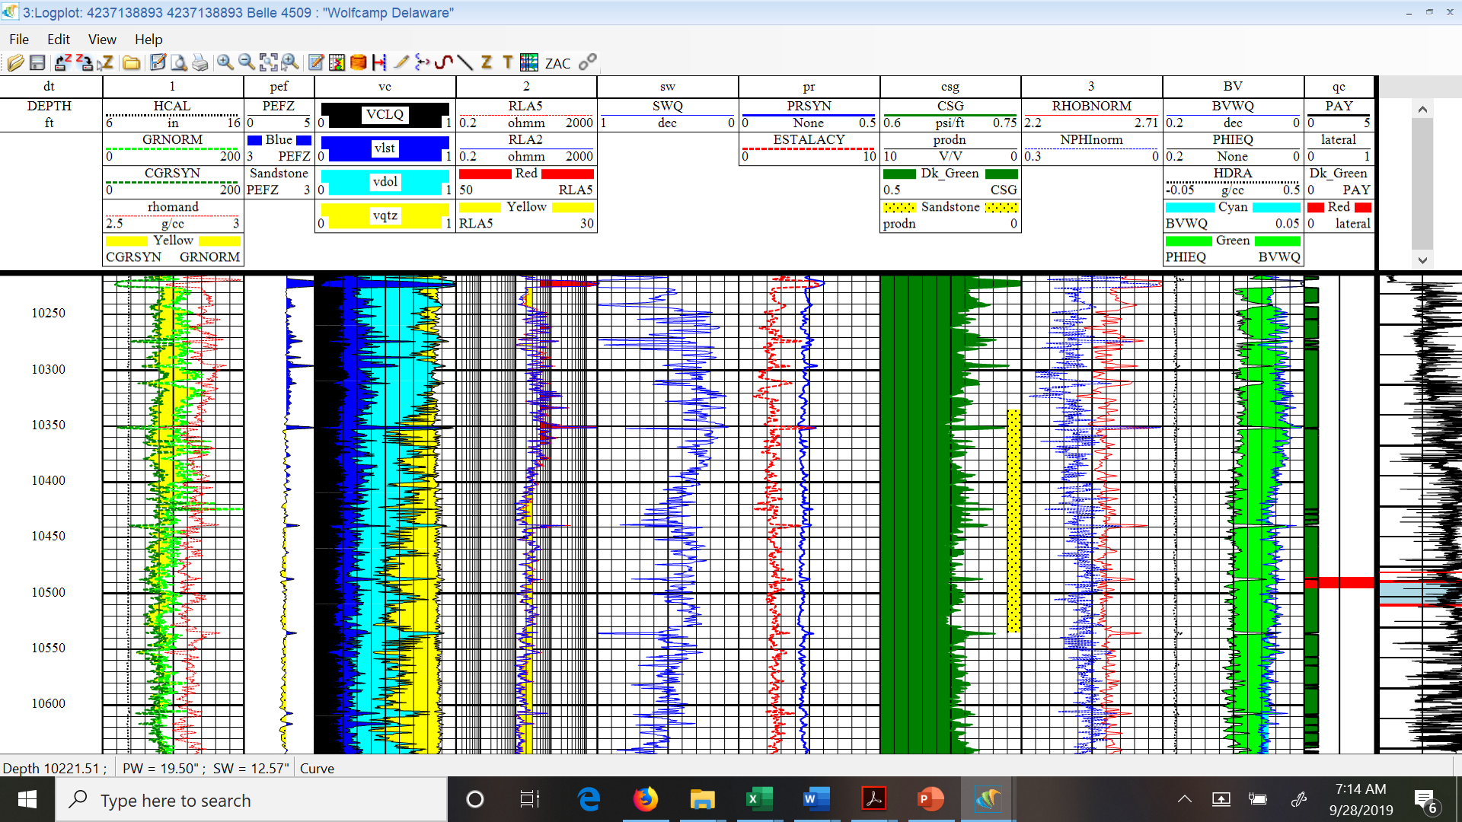
Pecos County Lateral OIP and Landing Zone Analysis
Barba and Leshchyshyn, “Evaluating Refrac Potential in the Permian Wolfcamp Formation,” SPE/ICOTA Refrac Workshop April 2017

Slide 11
Horizontal Organic Shale Refracs
As more infill wells were completed it became apparent that there were issues involved with Fracture Driven Interactions (FDI’s or “frac hits”)
Initially the focus was on avoiding production losses in the primary wells as infill well FDIs often damaged or killed the primary wells
As production was established it became apparent that the recovery factors of the initial infill wells were lower than what should be expected from the OIP and offset recovery factors normalized to the frac vintage
Recent work done by Elliott (2019) suggests that the only viable options for primary well protection are refracs and full volume preloads with water
The full volume preload requires replacement of 100% of the oil and water produced from where it was produced to fully restore original pore pressure

Slide 12
Infill Well Asymmetric Frac Closure Stress
Infill Well
Closure Stress
X psi
Primary Well
Closure Stress
< X psi
Frac Geometry
FDI likely
Stranded
Reserves
Infill well at
higher reservoir
pressure
Primary well at lower
reservoir pressure and
closure stress
Level of depletion probably not an issue, if stress lower frac will go there

Slide 13
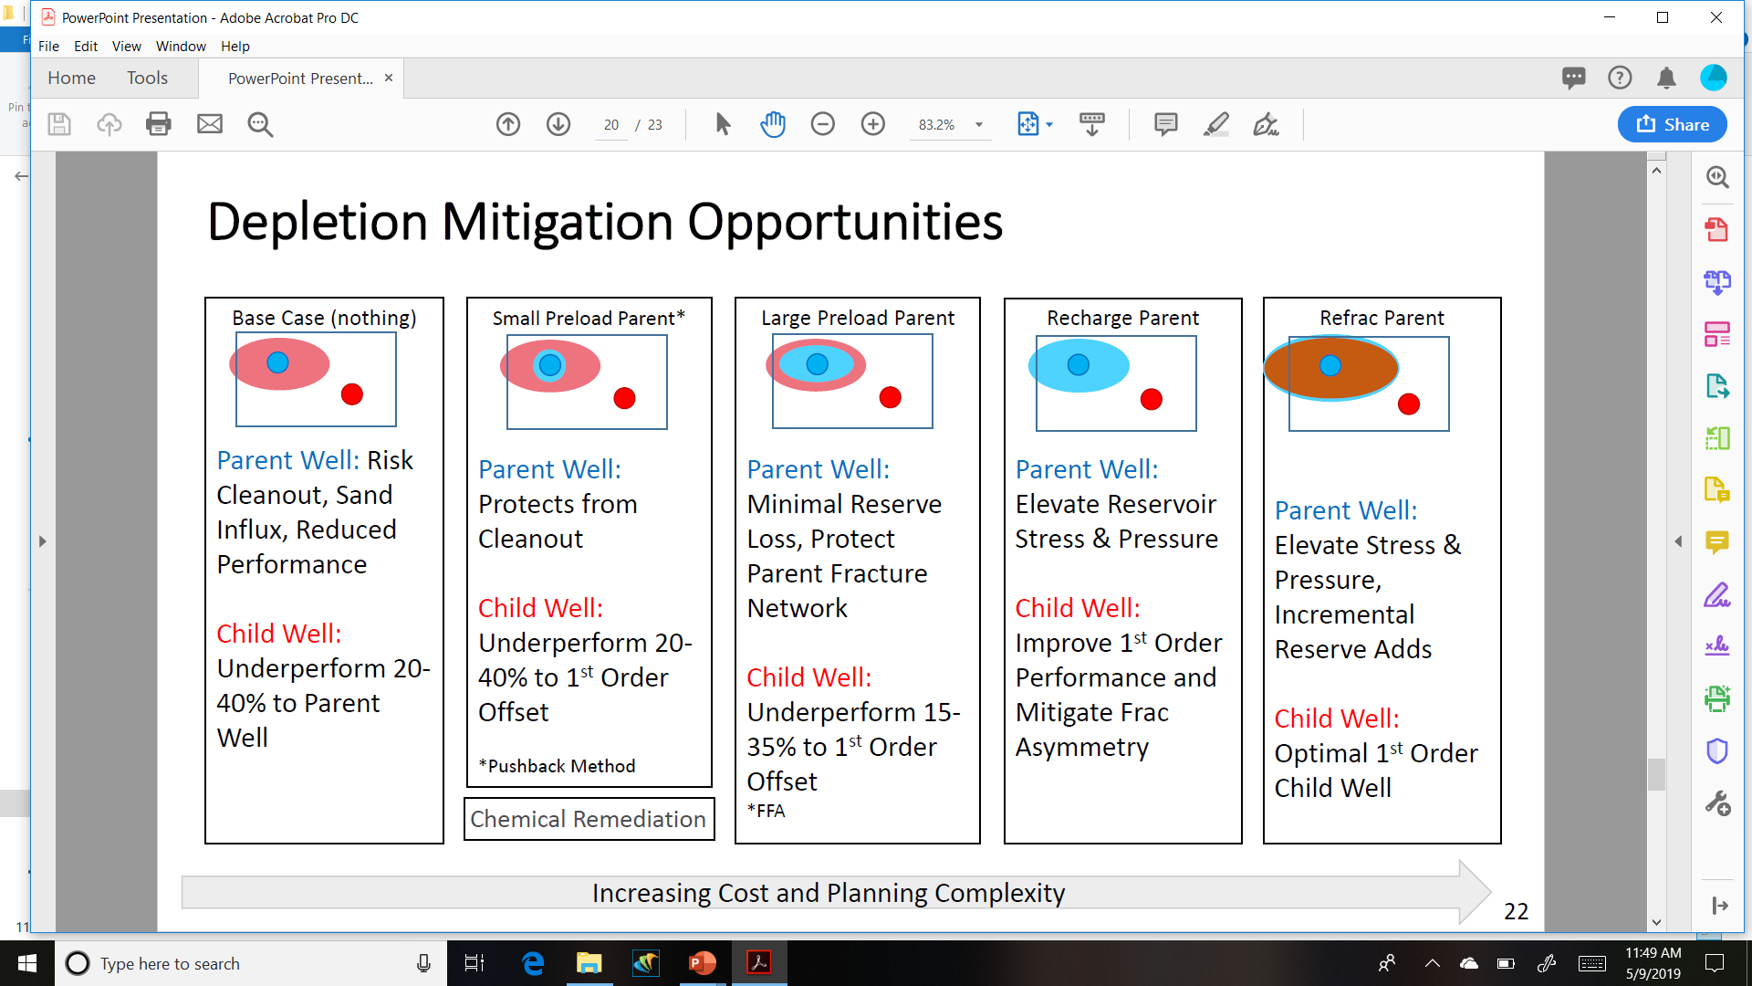
Depletion Mitigation Opportunities
100% restoration
of pore pressure
Elliott, Brendan, Well Completions for Unconventional Resource Development Optimization and Parent Child Interaction Workshop, April 2019

Slide 14
Depletion Mitigation Results
Red = stranded hydrocarbons

Slide 15
Refrac vs Full Volume Preload Comparison
Permian Wolfcamp Data
Barba and Leshchyshyn
2017 ICOTA/SPE Refrac
Assumes 600,000 BO liquids
GOR 1081/Nymex Strip

Slide 16
Primary Well Refrac Issues
The refrac treatment needs to recharge the existing clusters to prevent infill well asymmetric fractures
The treatment should access as much “new rock” as possible to increase primary well production as much as economically possible
Both mechanisms require complete isolation of the existing perforations to effectively stimulate both the new and existing clusters
Mechanical isolation is strongly recommended vs attempting to divert with chemicals, fiber, or ball sealers
The two viable options for mechanical isolation are expandable liners and cemented casing

Slide 17
Yes
Refrac needed-save
40% of infill well EUR
$PV10>> Full Preload
Primary Well?
No
Refrac Process
Flow Chart
Recovery Factor
Analysis
OIP Economic?
Yes
Refrac options review
OIP Economic?
No
Not a refrac
candidate
Most efficient: Expandables
Less efficient: Cemented liners
Random results: Diverters
Zipper fracs for
Infill wells on pad
Implement refrac
13.3 ft 1 shot/cluster
XLE & PnP Frac Gen 3+

Slide 18
Refrac Isolation Options
There are several options available for executing refracs using either diverters or mechanical isolation
For mechanical isolation the two main options are cemented or expandable liners
The combination of Extreme Limited Entry and expandable liners provides a means for:
Fewer stages than cemented liners via higher pump rates allowing for more clusters per stage
Lower cost of stimulation than cemented liners
Lower cost per barrel of oil produced than cemented liners
The process has similar benefits for new well completions

Slide 19
Perforating Best Practices Horizontal Wells
Latest advances in fiber optic technology have validated the minimum pressure drop across the perforations to maximize cluster efficiency
Two studies (SPE 189880/184834) have shown that 2000 psi is the minimum number for the pad and 1500 psi at the end of the job after perf erosion
Designing the completion for the 1500 psi post erosion target is recommended and this will typically result in an initial pressure drop greater than 2000 psi (2500 psi +/-)
Perforations need to be uniform size, conventional charges not used due to irregular hole sizes
A critical rate of 6 BPM/cluster is proposed and this typically overrides the number of clusters from the delta p calculation and larger holes are needed

Slide 20
Perforation Cluster Optimization
Soft rock (Eagle Ford, Woodford, Marcellus) recommended cluster spacing 13.3 ft to maximize SRV and recharge old fractures, 20 ft for Permian
Recommend 1 shot per cluster on the top of the casing to facilitate estimation of cluster efficiency from a step down test
Zero degree phasing is SOP for fiber optic wells and there are no indications that well performance has been affected
The recommended strategy is one 0.40-0.50 inch diameter hole per cluster
Target is to get at least a 2000 psi pressure drop across the perforations pre-erosion and a 1500 psi drop post-erosion
May need higher pressure drop if primary well highly depleted

Slide 21
XLE Optimization Spreadsheet

Slide 22
XLE and Fracture Driven Interactions
The shortened cluster spacing results in smaller fracs at each cluster with reduced frac height and frac length
PXD presented a microseismic survey from a shortened cluster spacing job (15-25 ft) that had the appearance of a “cigar” around the lateral
The shortened length of the frac reduces the probability of infill FDIs
XLE should be superior to intra-stage diversion in this regard as it divides the fluid flow relatively uniformly vs the random diversion process that can result in “flyers” taking off toward the offset primary well
The clusters need to be as close as possible (13 to 20 ft) to ensure existing drained clusters are recharged in addition to stimulating “new rock” in the SRV maximization process

Slide 23
XLE vs Diversion and Engineered Completions
While all three options have similar published cluster efficiencies in the 85% range, XLE is recommended over the other two options:
While intra-stage diversion is fine for new well completions, in a refrac they can prematurely plug off significantly depleted clusters and create an asymmetric fracture at that cluster
With typically large primary well cluster spacing this can be significant and infill well EUR losses can occur
For engineered completions the cluster spacing needs to be a maximum of 13-15 ft to avoid gaps in the SRV and to ensure proximity to depleted clusters. Closer spacing has been attempted in the low modulus Eagle Ford and the operator that tested that is now using 15 ft cluster spacing
This is exacerbated in higher modulus rock such as the Permian Basin organic shales, 20 ft spacing there is adequate based on tracer data

Slide 24
Summary and Conclusions
Refraccing organic shale primary wells is critical to the economics of a DSU
If an infill well frac hits the primary well depleted zones asymmetric fracs can result in a 40% EUR loss in the infill well ($6.8 MM PV10 600 MBO well)
“Preload” treatments do not prevent this loss unless 100% of the fluid removed from the reservoir is replaced and original pore pressure restored
Refracting the primary well has a $4.2 million incremental value over a full volume preload
While mechanical isolation with expandable liners, short cluster spacing, and XLE is more expensive on the front end than cemented liners the return on the incremental up front investment ranges from 1.7 to 2.3 vs 4 inch flush joint cemented and from 4.6 to 6.5 for 3.5 inch cemented liners

Slide 25
Thanks to:
Matt Meiners, Tina Tallant, Dustin Dell, and John Callais for their inputs

